Slide 1


Evolution Strategies for Autonomous Mobile Swarm Robots
Serge Saaybi
Thesis Status update report
TU Delft | 30 March 2021

Slide 2
Research Question
Two main topics
Feasibility study and implementation of a swarm system which detects social distancing violations in an environment up to a certain accuracy.
How well does MARL generalize to the number of agents in such a system? Does the system scale to various team sizes, world sizes, and obstacle densities?
Should the different robots be initialized based on a specific formation?
What should the distance between the robots be as to cover the whole area accurately?
Is a swarming system using ESs more performant than one using MARL for collision avoidance?
How well does MARL and Ess generalize to the number of agents in such systems? Which provides better scalability?
Which system outperforms the other for maples navigation in a crowded area?

Slide 3
Can we develop a swarm system for detecting social distancing violations in an environment?
Aspects to be considered
Are there similar solutions currently proposed?
Some research is done on the topic; however, they don’t utilize swarm robots.
Why a swarm of robots instead of CCTV camera?
Using CCTV- on-site monitoring system is not ubiquitous in some areas and sometimes it may not be able to cover all public corners. Furthermore, although this sort of monitoring system has detected social distancing violations, it fails to take any proactive actions to promote social distancing
There are four main parts to be considered for such a topic:
Path Planning: Each agent in a multi agent system should learn an effective strategy to explore the environment. This avoids collisions, maximizes system performance and prevents redundant work
Image recognition: Social distancing detection system with the ability to track the robot’s nearby pedestrian groups
Collision and crowd avoidance: Develop a collision avoidance algorithm allowing the robots to navigate in a highly dense and dynamic environment
Such a system can be used for multiple applications
Since it relies on image processing, swarm robots, MARL, collision avoidance, etc. It can be used for surveillance, search and rescue tasks, cleaning, warehouse automation, etc.

Slide 4
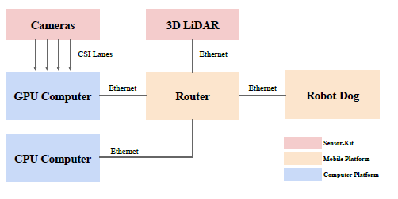
Literature Review
Autonomous Social Distancing in Urban Environments using a Quadruped Robot
Introduces a fully autonomous surveillance robot based on a quadruped platform that can promote social distancing in complex urban environments
Hardware: quadruped robot, multiple cameras and a 3D LiDAR.
(https://www.youtube.com/watch?v=t1gRBNOcmOw&ab_channel=TingxiangFan)
Overview:
Multiple cameras (4) and a 3D LiDAR on a legged robot
4 cameras for detecting and tracking pedestrians
3D LiDAR to measure the social distance between pedestrians, for mapping, localization, and collision avoidance
On-board realtime social distancing detection system
YOLO: detect pedestrians and generate bounding boxes for them
F-RVO: used to simulate motions in crowds
Crowd-Move algorithm for navigating the robot in highly dynamic environments.
CrowdMove: Collision avoidance algorithm
LeGOLOAM algorithm: generates a 3D point cloud map, used for mapping and localization (uses the Lidar)
Patroling algorithm: Based on the map, the robot chooses the direction where there is a high probability that a crowd would appear
Crowd-aware routing algorithm to approach over-crowded pedestrian groups
Crowd-aware routing algorithm: Considers the time constraints and size of crowds
Notes:
https://www.youtube.com/watch?v=t1gRBNOcmOw&ab_channel=TingxiangFan

Slide 5
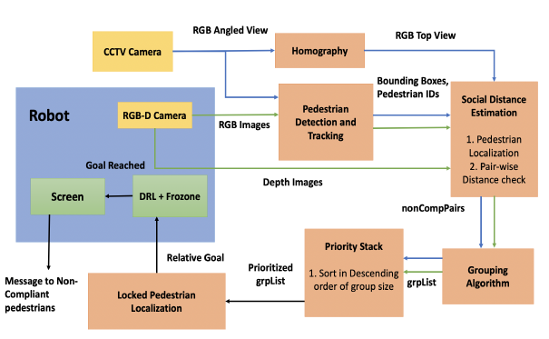
Literature Review
COVID-Robot: Monitoring Social Distancing Constraints in Crowded Scenarios
Presents a method to detect pairs of humans in a crowded scenario who are not adhering to the social distance constraint (6 feet of space between them). The robot prioritizes groups based on their size, navigates to the largest group and encourages following of social distancing norms by displaying an alert message on a mounted screen.
Hardware: Turtlebot 2 robot, RGB-D camera and a 2-D lidar to perform collision-free navigation in a crowd and estimate the distance between all detected individuals in the camera’s field of view. A thermal camera wirelessly transmits thermal images to a security/healthcare personnel for monitoring individuals’ temperature. A screen displays a message.
Overview:
DRL-Based Collision Avoidance:
Using the 2D lidar
Frozone method
Pedestrian Detection and Tracking
Yolov3 method
Breach Detection:
Detected by the robot’s RGB-D camera and/or the CCTV camera
The robot classifies People into groups
Metrics:
Accuracy of pedestrian localization
Number of breaches detected
Number of enforcements
Tracking Duration for a mobile pedestrian

Slide 6
Next Steps
Finalizing topic/ research question3
Go over the identified literature
Simulate my own environment in Pybullet (single and multi agent)
Notes:
Path planning in MARL:
Multi-agent Motion Planning for Dense and Dynamic Environments via Deep Reinforcement Learning
MAPPER: Multi-Agent Path Planning with Evolutionary Reinforcement Learning in Mixed Dynamic environments
Deep reinforcement learning based multi-agent pathfinding
PRIMAL: Pathfinding via Reinforcement and Imitation Multi-Agent Learning
Combining Deep Reinforcement Learning with Search Heuristics for Solving Multi-Agent Path Finding in Segment-based Layouts
UW-MARL: Multi-Agent Reinforcement Learning for Underwater Adaptive Sampling using Autonomous Vehicles
One-shot path planning for multi-agent systems using fully convolutional neural network
Grid Path Planning with Deep Reinforcement Learning: Preliminary Results
Virtual-to-real Deep Reinforcement Learning: Continuous Control of Mobile Robots for Mapless Navigation

